Slide 1

SDZWA Sensor Dashboard
Project Update
May 5, 2022

Slide 2
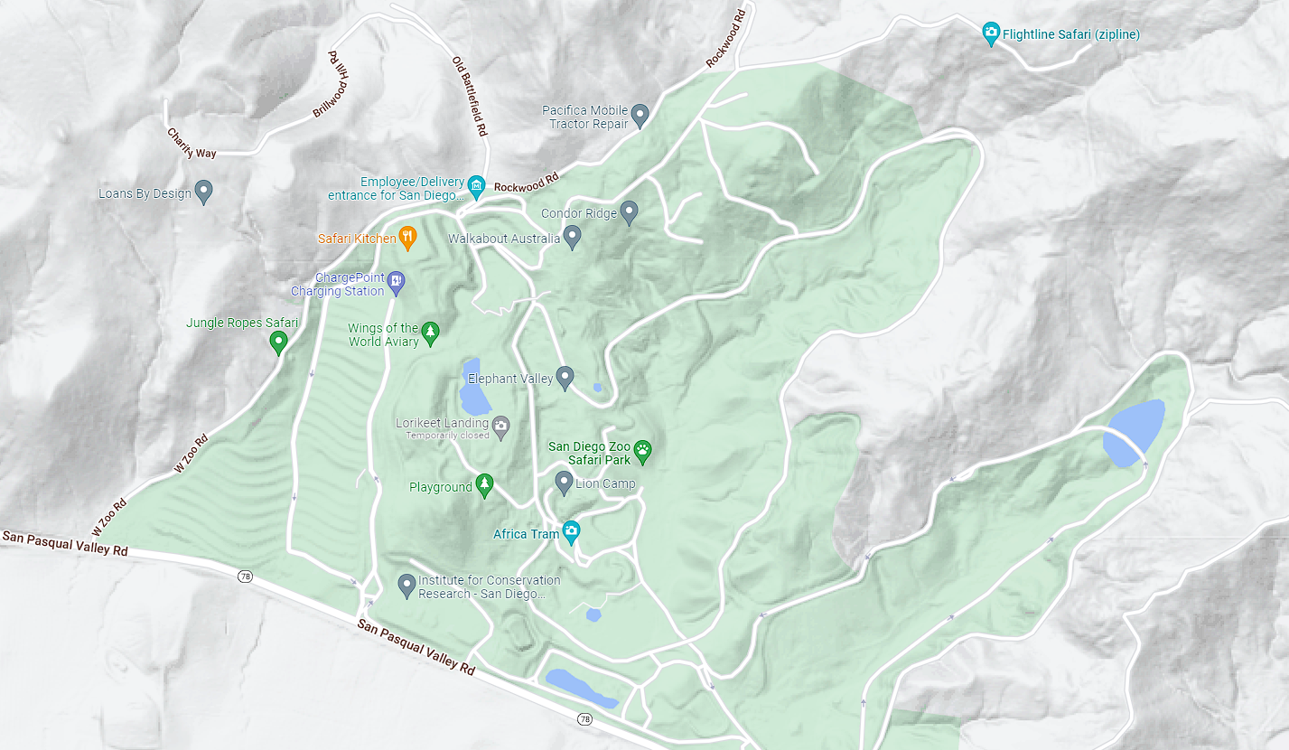
Motivation
Researchers at the Zoo manage a variety of sensors including IP cameras, weather stations, and microphones.
There is currently no centralized method of collection, storage, or visualization of data from these sensors.
San Diego Zoo Safari Park covers 1,800 acres.
Notes:
The San Diego Zoo and Wildlife Alliance maintains large amounts of land, hosting over 3,500 animals.
Need an interface to manage and monitor the health of these sensors.

Slide 3
Project Overview
Web application that can help researchers view and manage a tile dashboard displaying audio, video, and numerical data from various sensors in the San Diego Zoo Wildlife Alliance

Slide 4
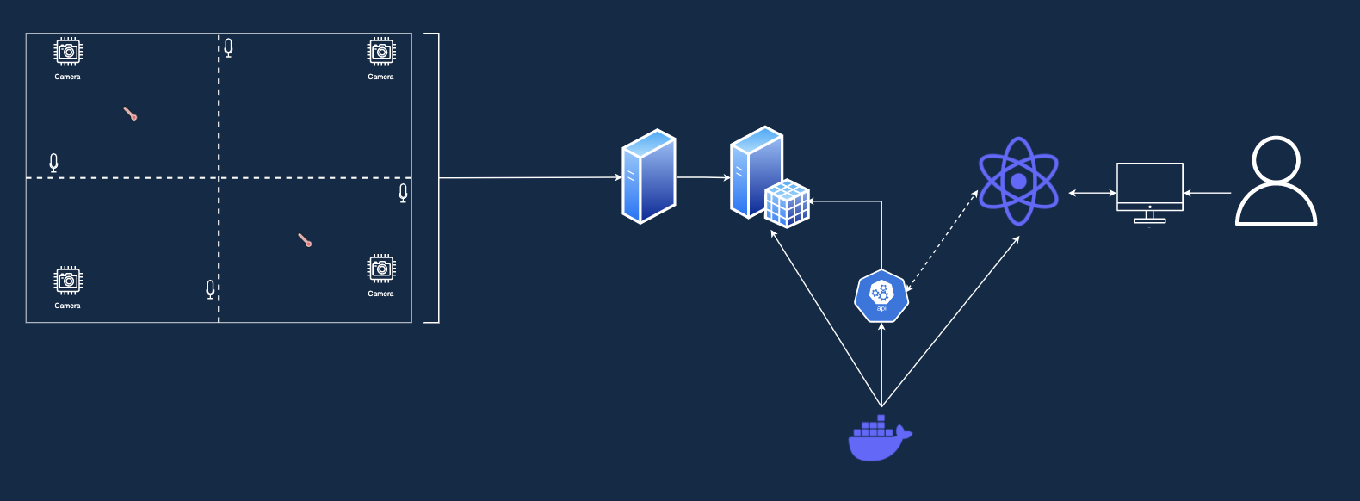
Big Picture
Database
Web App
Local Data Store
Device
User
APIs
Zoo Sensor Network
Deployment

Slide 5


Objectives
Create administrative backend for sensor data
Web application with user accounts & tokenized invites
Configurable Dashboard tile view for Sensor Data
Create & use APIs for serving data in various formats
Ability to add, remove, edit individual sensor display
Ensure data security for sensor and user information
Front End
Back End

Slide 6
SDZWA Sensor Dashboard
Frontend
Project Update
May 5, 2022

Slide 7
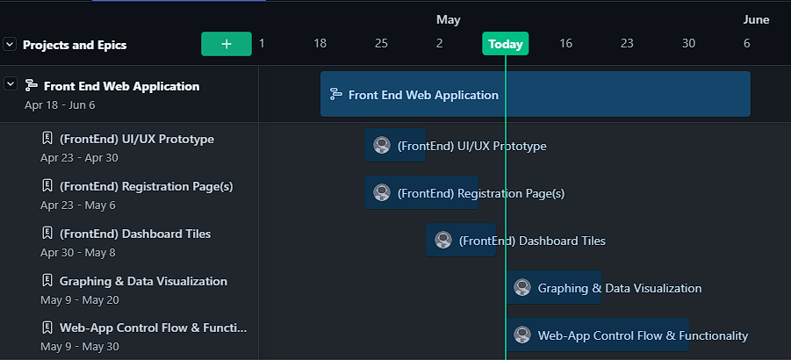
Quarter Plan

Slide 8
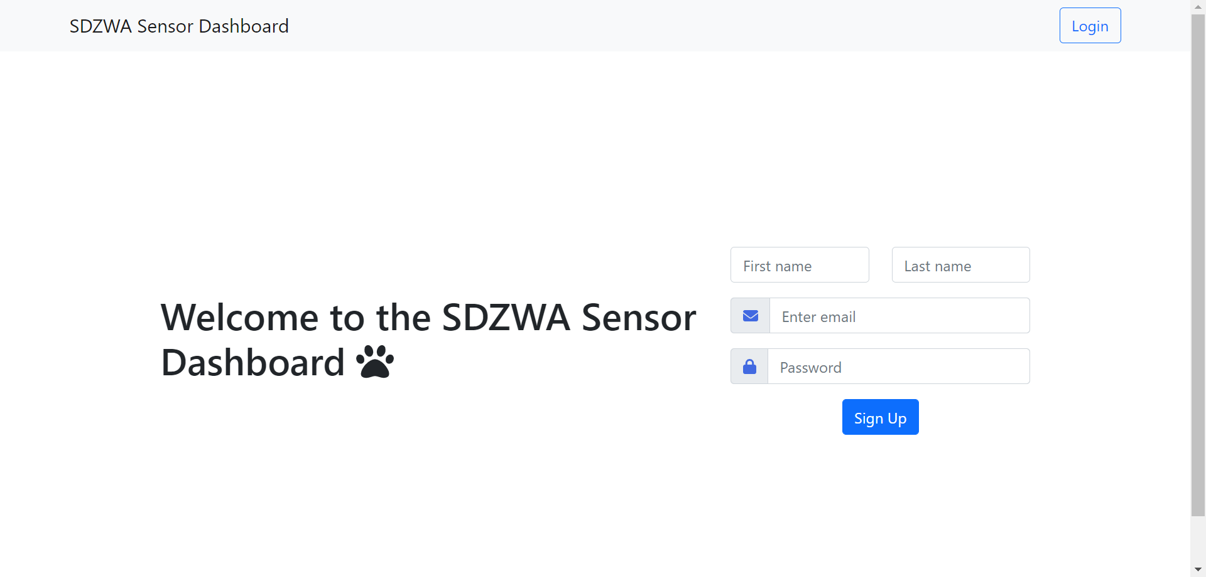
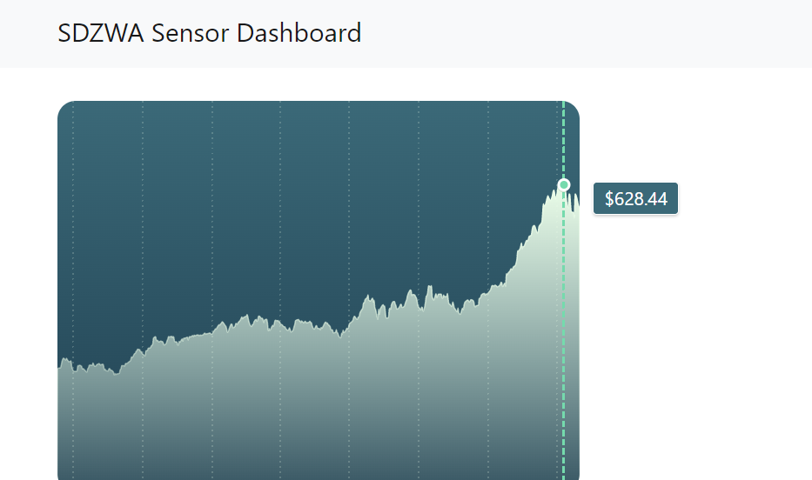
Progress
Registration & Login Pages have been implemented in React.
Dashboard Page in progress, working on graphing real data and adding more tiles.

Slide 9
SDZWA Sensor Dashboard
Backend
Project Update
May 5, 2022

Slide 10

Sensor Dashboard Backend Goals
Metadata Schema
Administrative Schema
Goal : Sensor Health
Goal : Administrative Access to dashboard

Slide 11
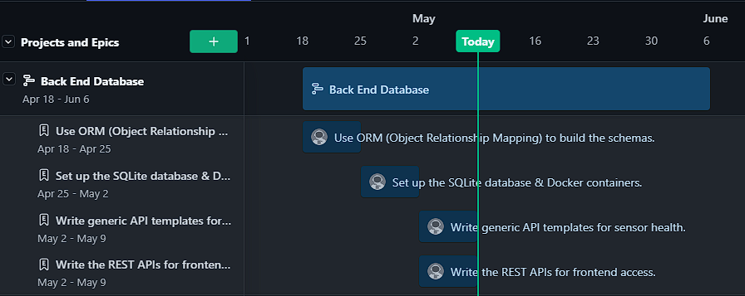
Quarter Plan

Slide 12
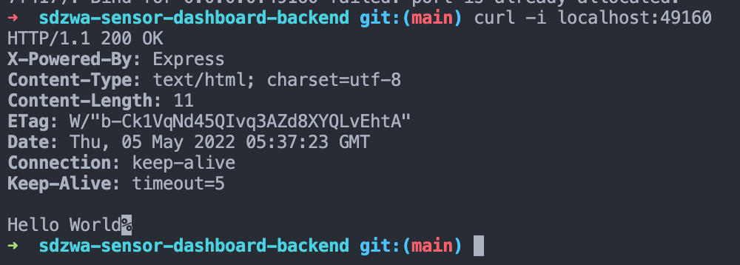

Progress
Server hosting on Docker implemented
Next step is to implement Object Relational Mappings and SQLite database hosting on the server

Slide 13
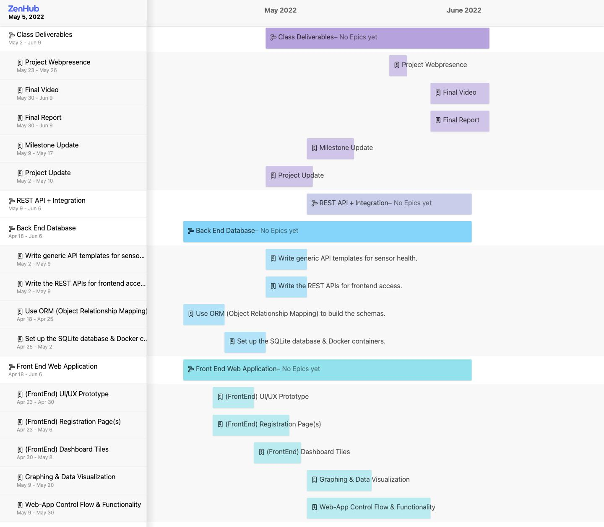
Wrapping Up
Priorities
Web app visualization and integration
Database functionality and integration
Class deliverables & collaboration

Slide 14
High - Level Roadmap to our MVP
STEP 1: Set up the SQLite database & Docker containers. ✅
STEP 2: Use ORM (Object Relationship Mapping) to build the schemas. ✅
STEP 3: Write the REST APIs for frontend access.
STEP 4: Write generic API templates for sensor health.

Slide 15
Week | Milestone | Team members working on Milestone | In - charge | Maximum Buffer Time - Manage risks
5 | Generic React App | Frontend Team | - | 1 days
5 | Registration/ Authentication flow | Frontend Team | Malcom | 3 days
6 | Dashboard Tile View | Frontend Team | Ahmed | 5 days
7 | Graphing + Data Visualization | Frontend Team | Brandon | 7 days
8 | Integration work with back end | Backend Team + Frontend Team | - | 7 days
9 | Complete System Integration | Backend Team + Frontend Team | Brandon | 3 days
10 | Report, Video Recording | Backend Team + Frontend Team | Brandon / Akshaya | 1 day
11 | Final Demo, Wrap up | Backend Team + Frontend Team | Brandon / Akshaya | -

Slide 16
Week | Milestone | Team | In-charge | Max. Buffer
5 | Set up database schema for sensors | Backend Team | Akshaya | 10 days
6 | Creating generic API templates | Backend Team + Frontend Team | Ethan | 3 days
7 | Integration with frontend | Backend Team + Frontend Team | Jiping | 5 days
8 | API templates for processing sensor data | Backend Team | Ethan | 3 days
9 | API templates to check sensor conditions | Backend Team | Jiping | 3 days
9 | Complete System Integration | Backend Team + Frontend Team | Brandon / Akshaya | 3 day
10 & 11 | Final Demo, Report and Video | Backend Team + Frontend Team | Brandon / Akshaya | -

